Slide 1

Integrating Type Operators into the FreeST Programming Language
INForum, Lisbon, 5th September 2024
Paula Lopes
Advisors: Diana Costa, Vasco T. Vasconcelos

Slide 2

Introduction
Session Types
Communication Protocols
Type equivalence
Do two types denote the same protocol?

Slide 3

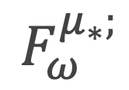
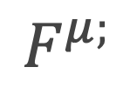
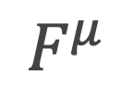
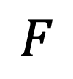
Introduction
FreeST (3.0)
FreeST (3.5)
$$F$$
$$F^{μ}$$
$$F^{μ;}$$
$$F_{ω}^{μ_{∗};}$$

Slide 4

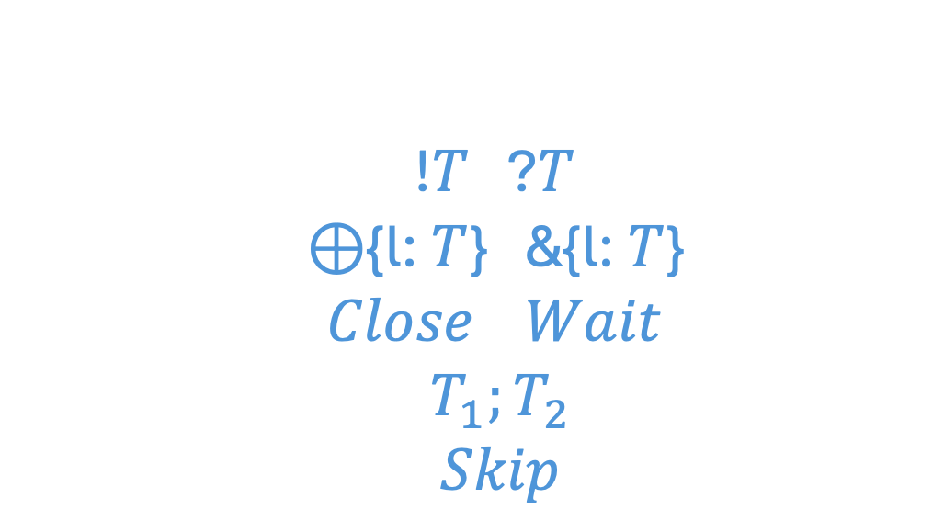
Context-free Session Types
!$T$ ?$T$ ⊕{l: $T$} &{l: $T$} $Close$ $Wait$ $T_{1};T_{2}$ $Skip$
send/receive internal/external choice close/wait channel sequential composition no operation
FreeST (3.0)

Slide 5
Beyond Context-free Session Types
μα: S.&{Leaf: Skip, Node: α ; ?Int ; α} ; Wait
λβ: T.μα: S.&{Leaf: Skip, Node: α ; ?β ; α} ; Wait
FreeST (3.5)

Slide 6

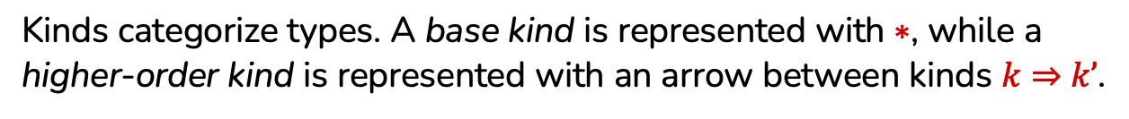
Kind
Kinds categorize types. A base kind is represented with $∗$, while a higher-order kind is represented with an arrow between kinds $k⇒k’$.
Proper Type
A proper type has a base kind.
Type Operator
A type operator acts upon types to create more complex types.
Notes:
; aplicado a T1, aplicado a T2

Slide 7
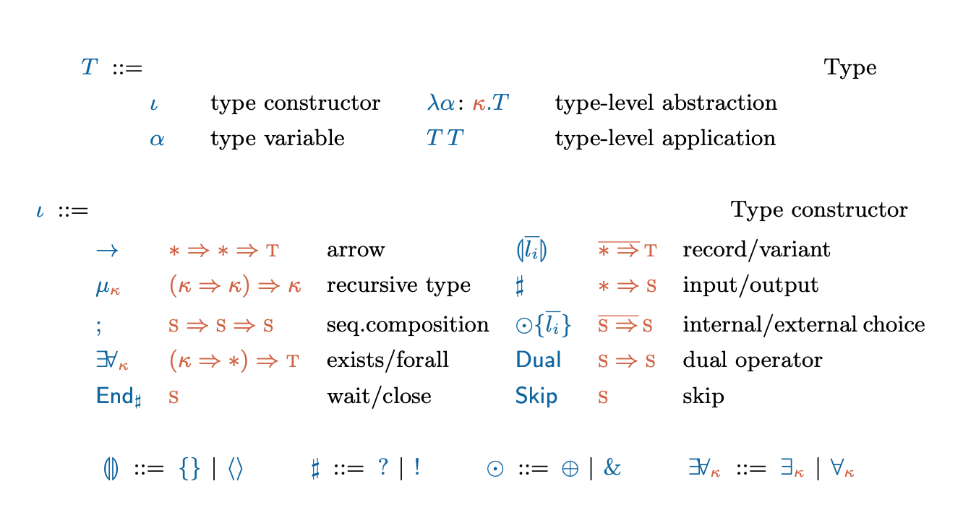

System $F_{ω}^{μ_{∗};}$

Slide 8
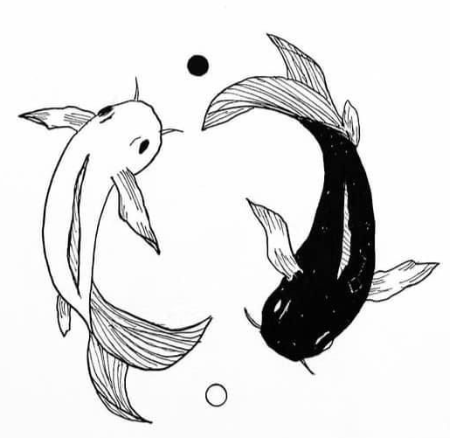
Duality

Slide 9
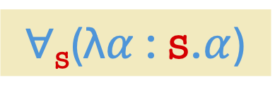
Dual ?
!Int
$∀$_{s}(λ$α$ : s.$α$)

Slide 10
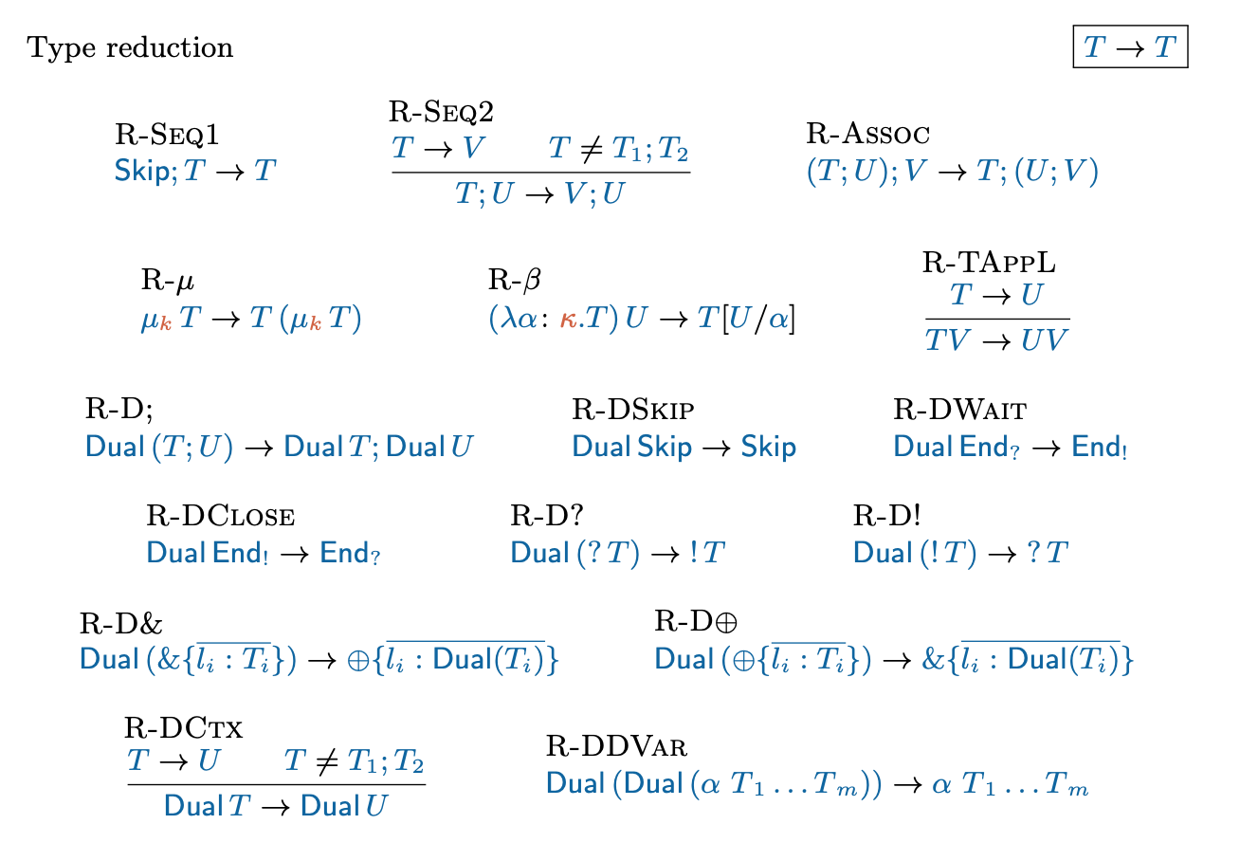
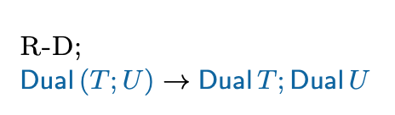
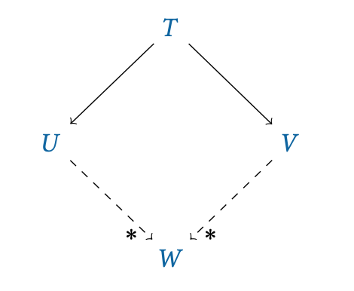
Reduction Rules
Confluence
If there are two distinct reductions for a given type, $T →U$ and $T →V$,
then both paths will eventually converge into the final reduced type $W$.

Slide 11
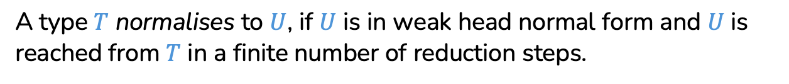
Weak Head Normal Form
A type is in weak head normal form if no reduction rule can be applied.
Normalisation
A type $T$ normalises to $U$, if $U$ is in weak head normal form and $U$ is reached from $T$ in a finite number of reduction steps.

Slide 12
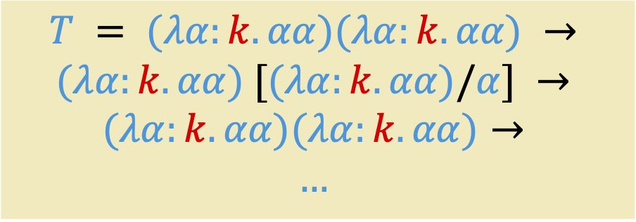

$T$ does not normalise
$$T = (λα:k. αα)(λα:k.αα) →$$
$$(λα:k.αα) [(λα:k.αα)/α] →$$
$$(λα:k.αα)(λα:k.αα)→$$
$$…$$
Stuck in a loop of reductions.

Slide 13
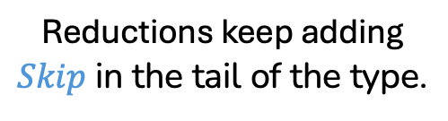

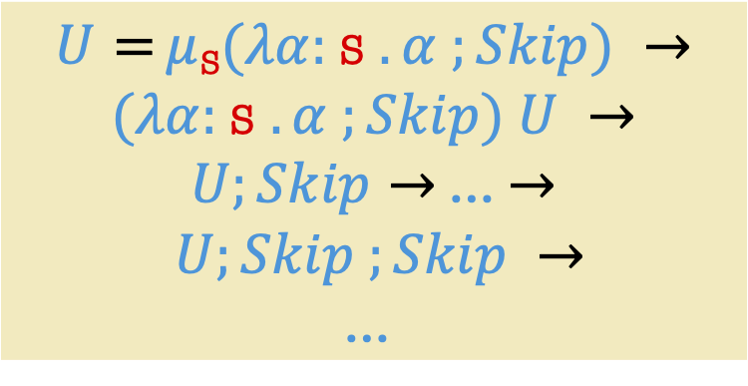
$U$ does not normalise
$U =μ$_{S}$(λα:$S $.α ;Skip) →$
$(λα:$S $.α ;Skip) U →$
$U;Skip→$ … $→$
$$U;Skip ;Skip →$$
$$\text{…}$$
Reductions keep adding $Skip$ in the tail of the type.

Slide 14
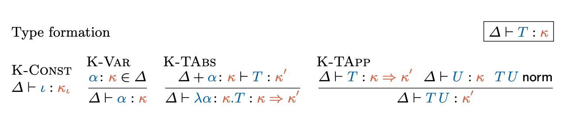
Type Formation

Slide 15
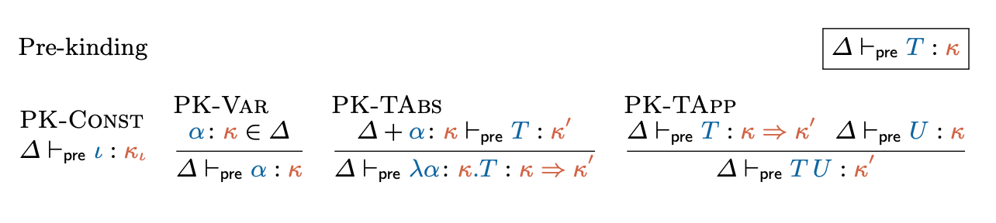
Algorithmic Type Formation
Notes:
If T is pre-kinded, T norm terminates.

Slide 16

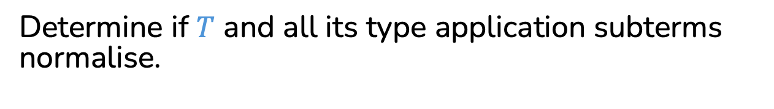

Check if $T$ is well-formed
First step
Determine if $T$ is pre-kinded, $⊢_{pre}T :κ$.
Second step
Determine if $T$ and all its type application subterms normalise.
Notes:
If T is pre-kinded, T norm terminates.

Slide 17
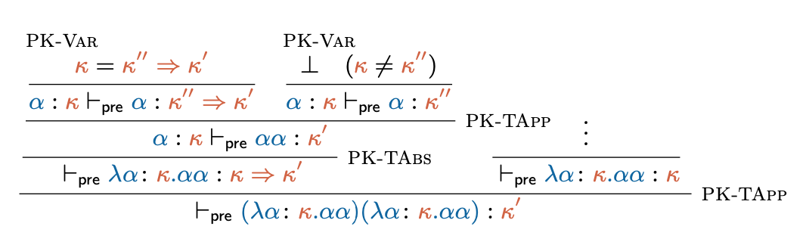

Slide 18
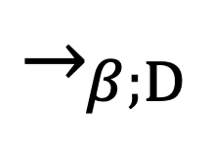
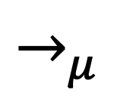
$→_{μ}$
$$→_{β;D}$$
$$T=T_{0}⇓_{β;D}T_{0}^{′}→_{μ}T_{1}⇓_{β;D}T_{1}^{′}→_{μ}T_{2}⇓_{β;D}T_{2}^{′}→_{μ}…$$

Slide 19
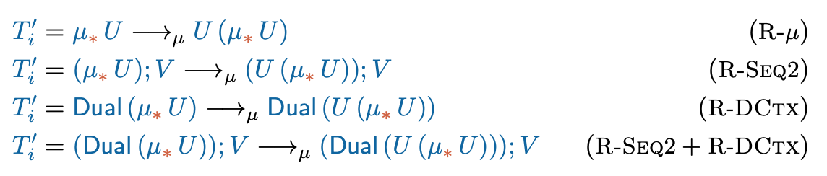

Slide 20
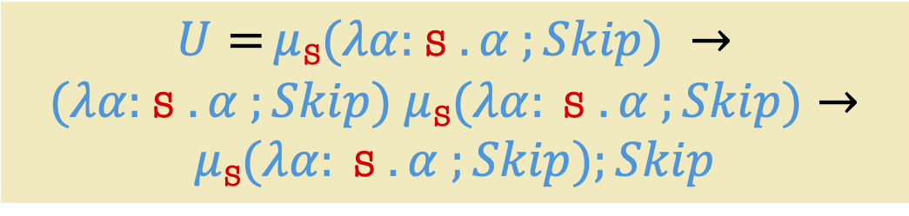
$U$ does not normalise
$U =μ$_{S}$(λα:$S $.α ;Skip) →$
$(λα:$S $.α ;Skip) μ \text{S}(λα: \text{S} .α ;Skip)→$
$$μ \text{S}(λα: \text{S} .α ;Skip);Skip$$

Slide 21
Type equivalence
Two types are equivalent if their corresponding grammars are bisimilar.

Slide 22
Type equivalence
Type equivalence allows checking whether two types correspond to the same protocol. Two types are equivalent if their corresponding grammars are bisimilar.
Minimal Renaming
Minimal renaming consists on renaming bound variables in a type by the smallest possible variable available.

Slide 23
Grammar in Greibach Normal Form
A grammar in GNF is a tuple (T , N , γ, R):
- T is a finite set of terminal symbols;
- N is a finite set of non-terminal symbols;
- γ is the starting word;
- R is a finite set of production rules.

Slide 24


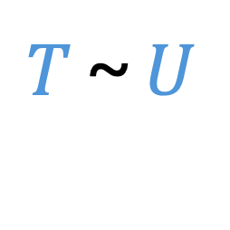
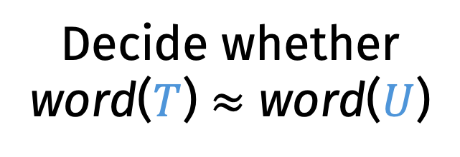
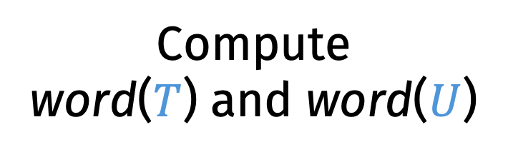
Decidability of Type Equivalence
$T$ ~ $U$
Compute word($T$) and word($U$)
Decide whether
word($T$) $≈$ word($U$)

Slide 25
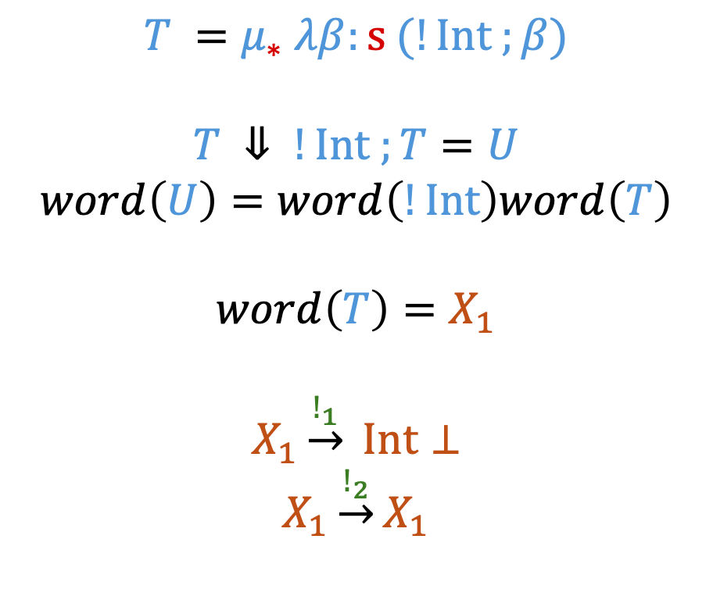

Translating $T$ into a Grammar
$$T =μ_{∗} λβ:s (!Int ;β)$$
$$T ⇓ !Int ;T=U$$
$$word\left(U\right)=word\left(!Int\right)word\left(T\right)$$
$$word\left(T\right)=X_{1}$$
$$X_{1}\underset{→}{!_{1}} Int⊥$$
$$X_{1}\underset{→}{!_{2}}X_{1}$$
Notes:
The application of the word function to T terminates producing a simple grammar (because our well-formed types normalise).

Slide 26
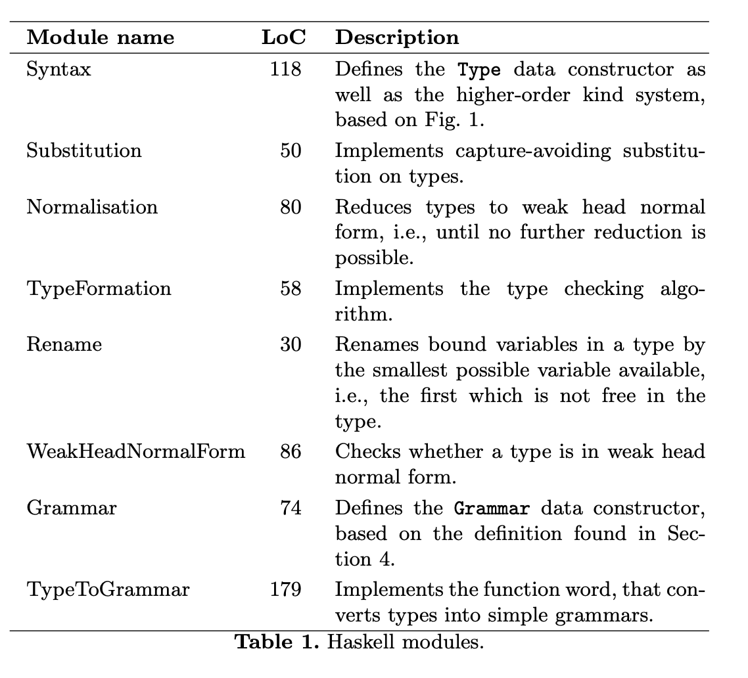
Implementation
Notes:
The application of the word function to T terminates producing a simple grammar (because our well-formed types normalise).

Slide 27
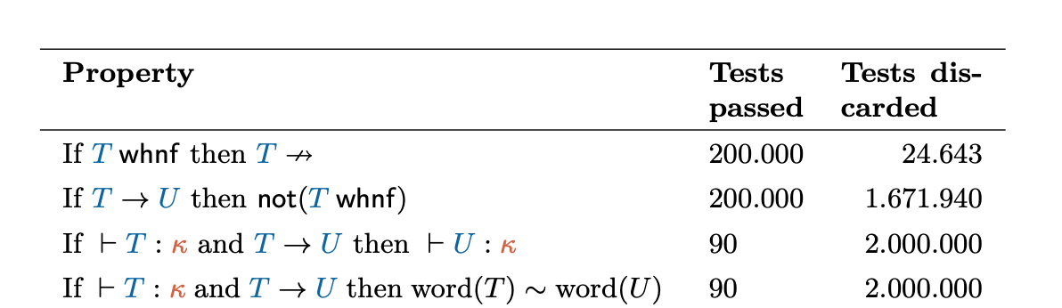
Validation

Slide 28

Thank you!
Questions?

